Slide 1
Astronomical Parameters
Lecture 2: Distance, Radii, Temperature, Mass

Slide 2
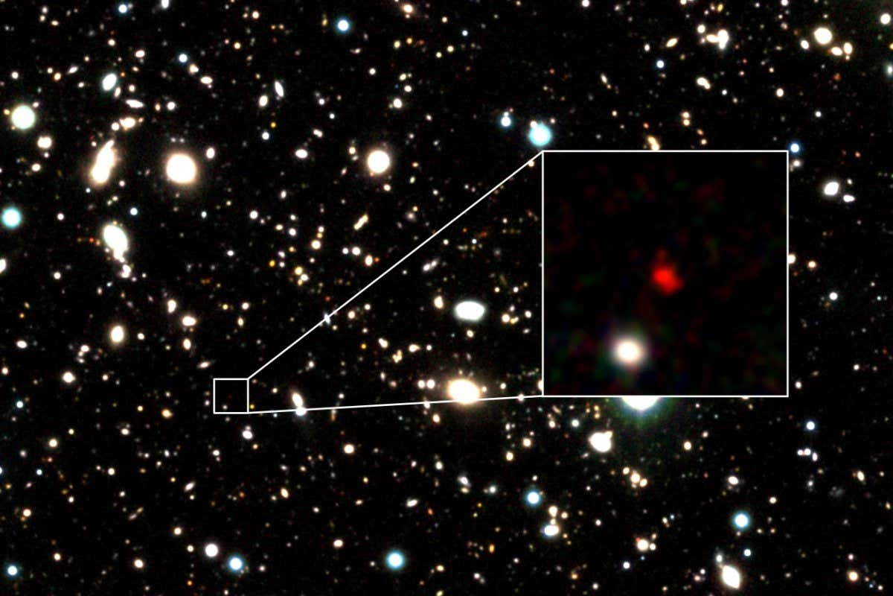
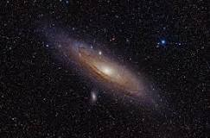
I. DISTANCE
Farthest known Galaxy: HD1: 13.4 billion light years.
Closest: Andromeda (M31): 2 million light years.

Slide 3
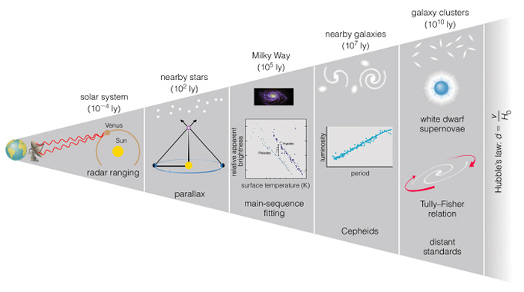
Cosmic Distance Ladder

Slide 4
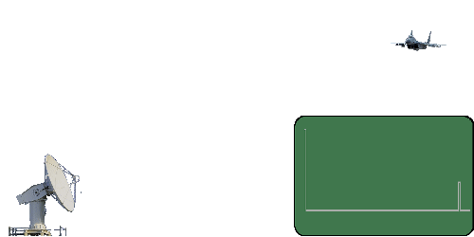
Cosmic Distance Ladder 1. Radar Range (within Solar System)
The radar transmits a short radio pulse with very high pulse power that propagates in this given direction with the speed of light.
If in this direction is an obstacle, for example an airplane, then a part of the energy of the pulse is
scattered in all directions. A very small portion is also reflected and the radar evaluates the contained information.

Slide 5
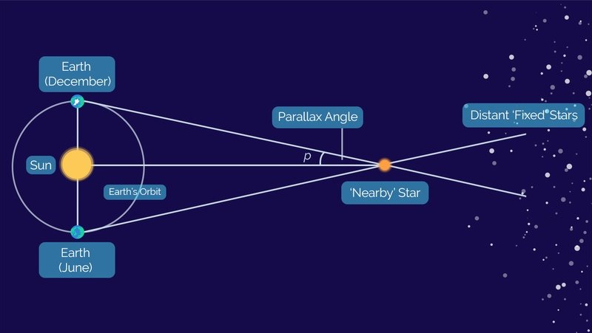
Cosmic Distance Ladder 2. Parallax (Nearby Stars)
https://www.youtube.com/watch?v=XUQAIldqPww
d = 1/p (d is in parsecs and p in arcseconds)

Slide 6
Cosmic Distance Ladder Parallax (Nearby Stars)
d = 1/p (d is in parsecs and p in arcseconds)
An arcsecond (denoted by the symbol “) is an anglular
measurement equal to 1/3600 of a degree or 1/60 of an
arcminute. There are also 206,264.5” in a radian, so that 1”
= 4.848 ×10⁻⁶ radians.
Limitations: Parallax angles of less than 0.01 arcsec are very
difficult to measure from Earth because of the effects of the
Earth's atmosphere. This limits Earth based telescopes to
measuring the distances to stars about 1/0.01 or 100 parsecs away.

Slide 7
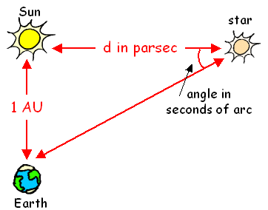
Cosmic Distance Ladder Parallax ( Nearby Stars )
d = 1/p (d is in parsecs and p in arcseconds)
1 AU = average distance between Sun and Earth = 1.496 × 10⁸km

Slide 8
Cosmic Distance Ladder Parallax (Nearby Stars)
d = 1/p (d is in parsecs and p in arcseconds)
More accurately, the IAU has defined the AU as:
“equal to the distance from the centre of the Sun at which a particle of negligible mass, in an unperturbed circular orbit, would have an orbital period of 365.2568983 days.”
Direct Method: Most Accurate
The first stellar parallax (of the star 61 Cygni) was measured by Friedrich Wilhelm Bessel (1784-1846) in 1838. Bessel is also known for the Bessel functions in mathematical physics.

Slide 9
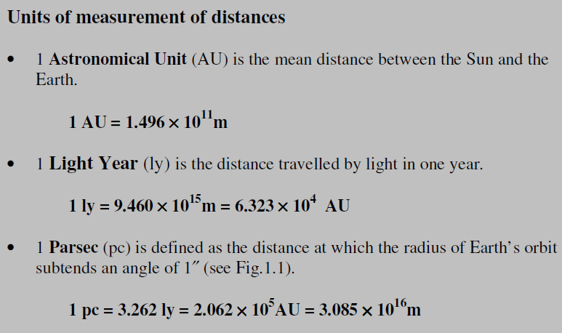
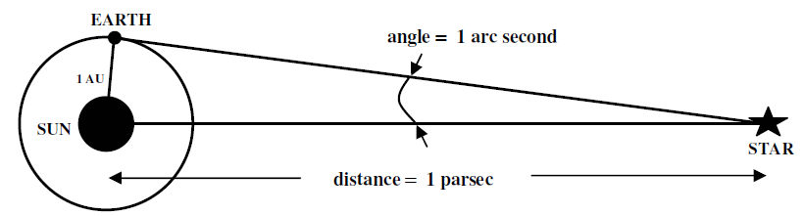

Slide 10
Distance (Parallax)
Q1. Sirius, a binary star in our galaxy, is a distance of 2.64 parsecs away from us. What would the parallax angle in arcseconds be for this binary star?
1/2.64 = 0.38 arcseconds
Q2. Star A has a parallax angle of 0.82 arcseconds, and Star B has a parallax angle of 0.45 arcseconds. Which star is closest to Earth, and by how much?
Star A (1.22 pc) is closest to Earth. It is 1 parsec closer than Star B (2.22 pc).

Slide 12
Cosmic Distance Ladder 3. Main-Sequence Fitting
Einar Hertzsprung and Henry Norris Russell plotted stars on a chart of luminosity and temperature. Most stars fall on a single track, known as the Main Sequence now known as the H-R diagram.
When looking at a cluster of stars, the apparent magnitudes and colors of the stars form a track that is parallel to the Main Sequence, and by correctly choosing the distance, the apparent magnitudes convert to absolute magnitudes that fall on the standard Main Sequence.

Slide 13
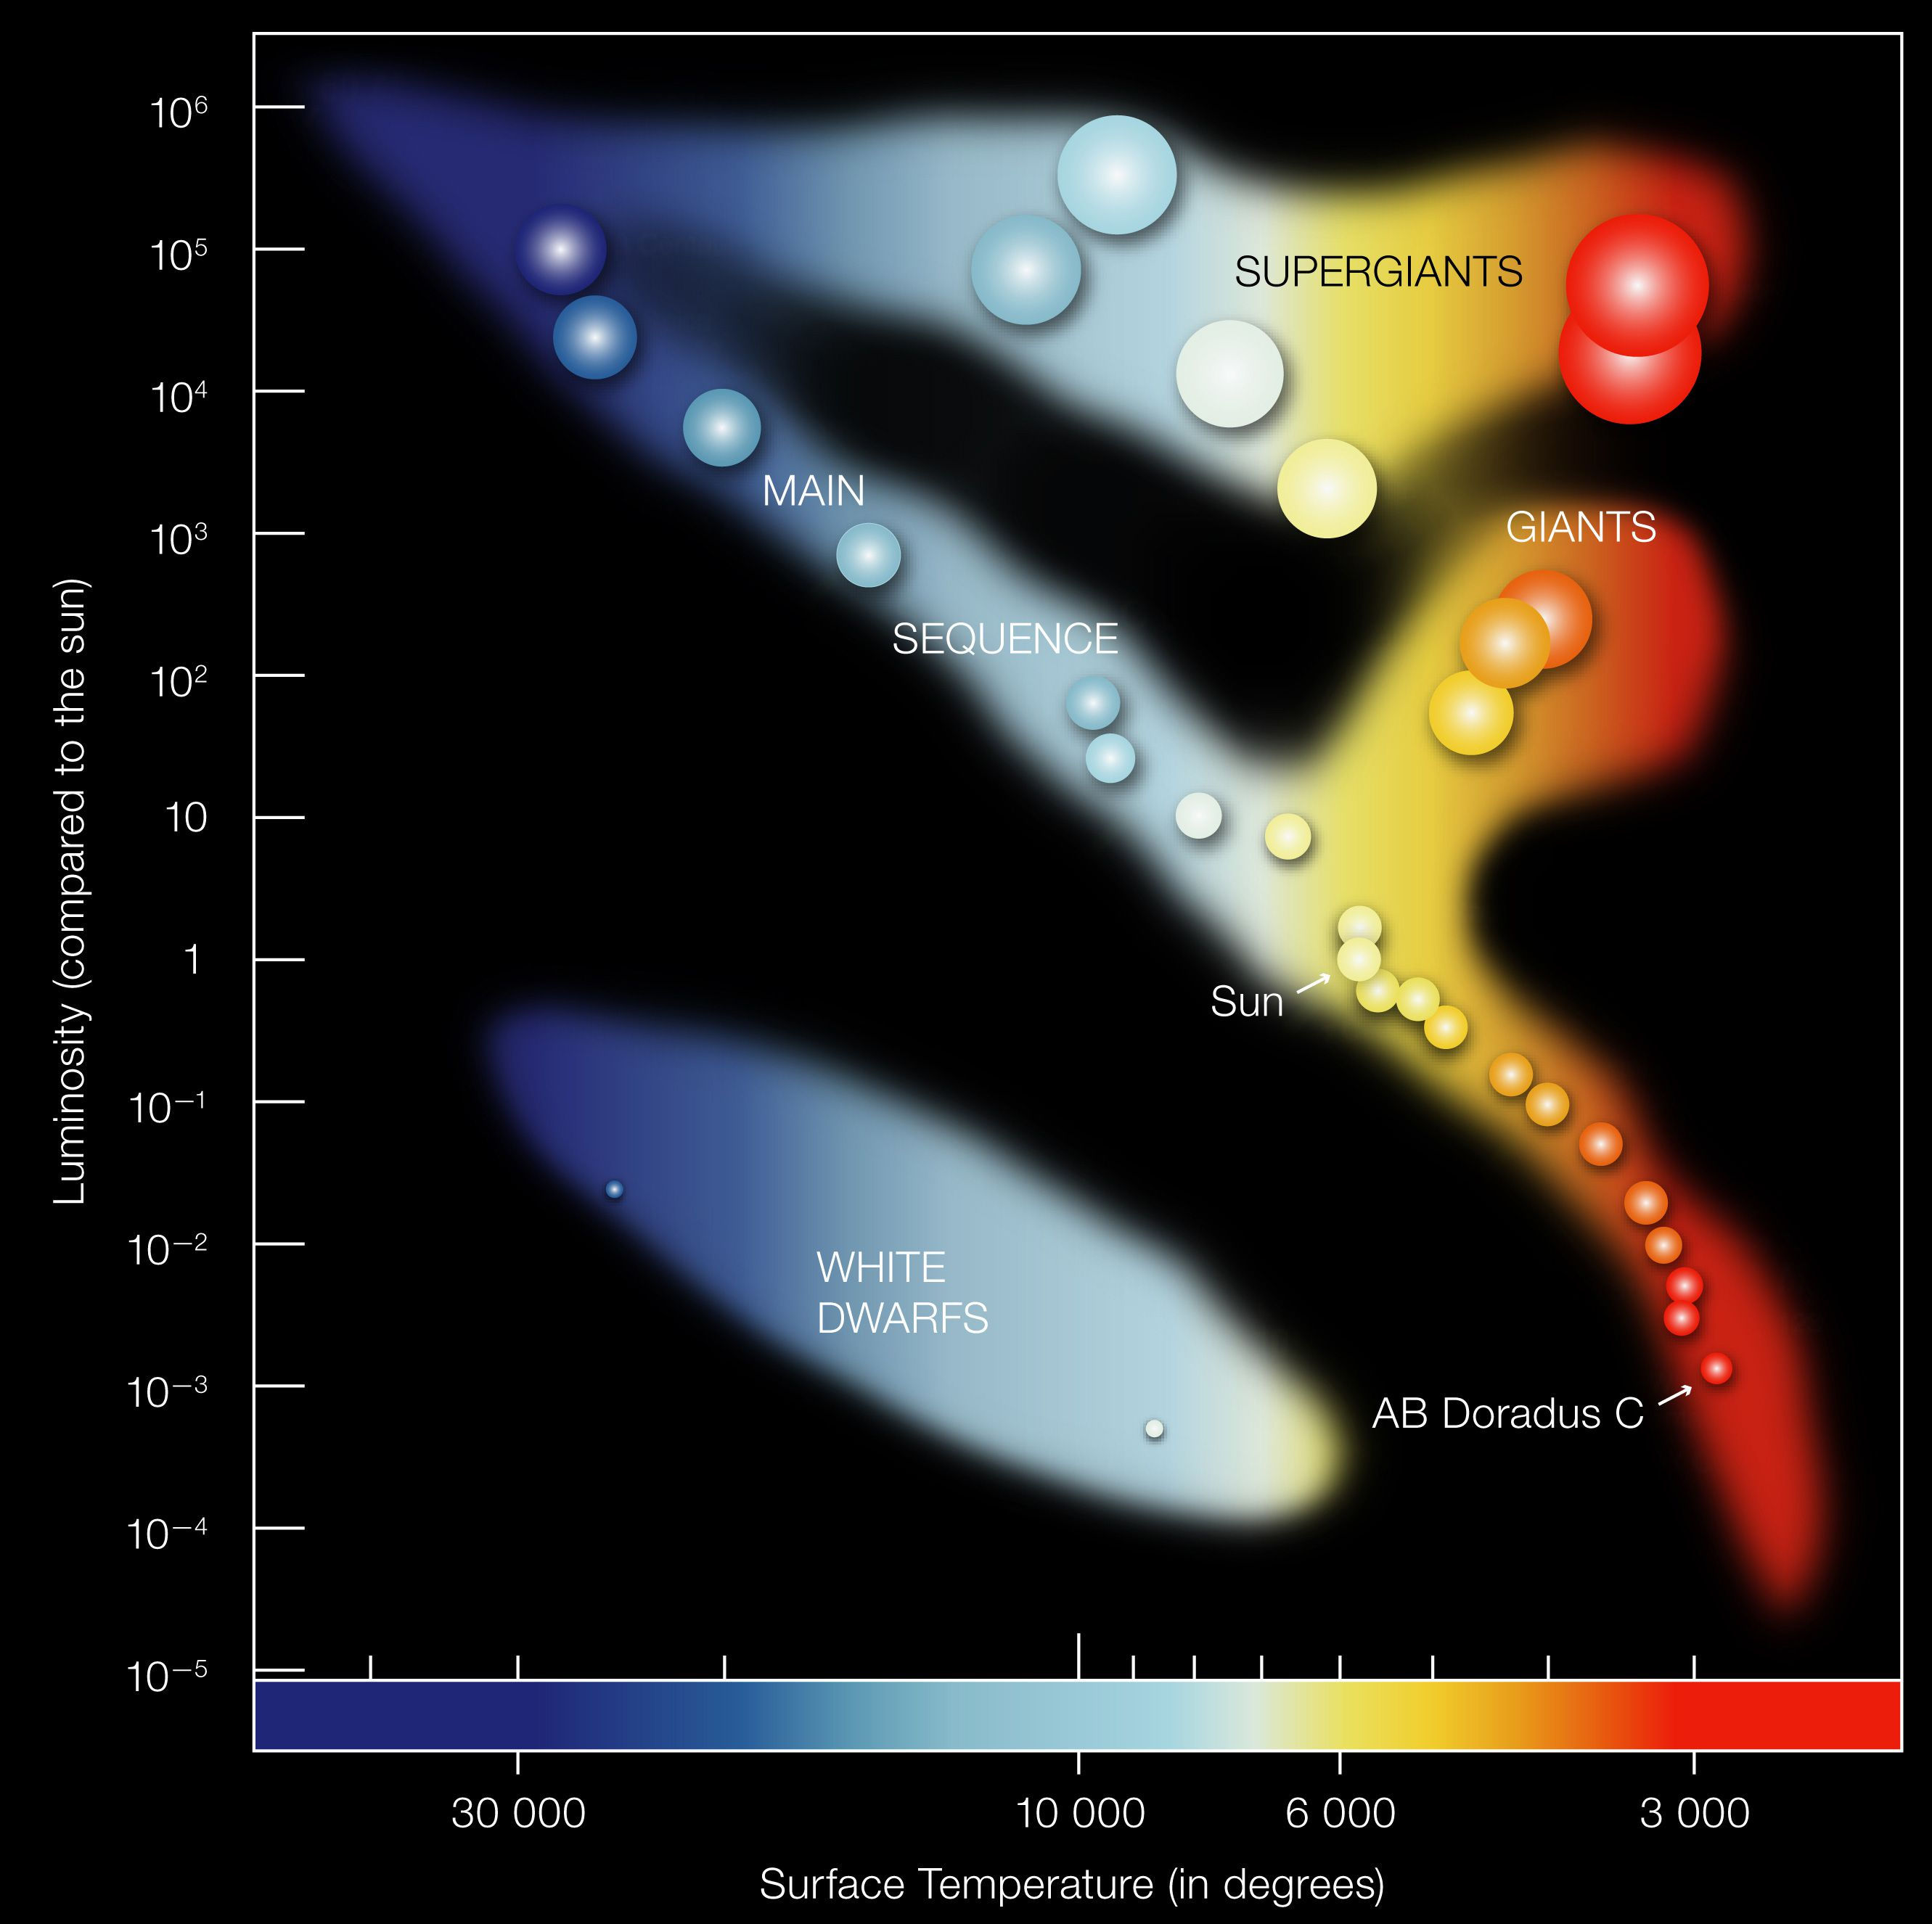

Slide 14
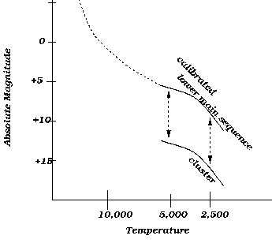

Slide 15
APPARENT MAGNITUDE (m): Astronomers use the term apparent magnitude to describe how bright an object appears in the sky from Earth. The idea of a magnitude scale dates back to Hipparchus (around 150 BC) who invented a scale to describe the brightness of the stars he could see. He assigned an apparent magnitude of 1 to the brightest stars in the sky, and he gave the dimmest stars he could see an apparent magnitude of 6. He did not include the sun, moon, or planets in his system.
The response of the eye to increasing brightness is nearly logarithmic. We, therefore, need to define a logarithmic scale for magnitudes in which a difference of 5 magnitudes is equal to a factor of 100 in brightness.

Slide 16
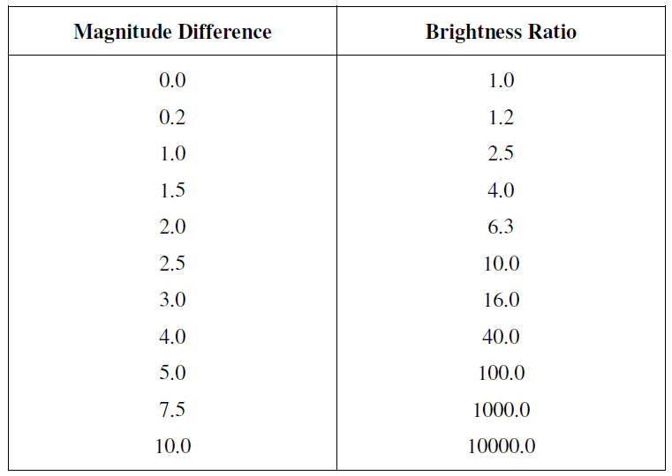

Slide 17
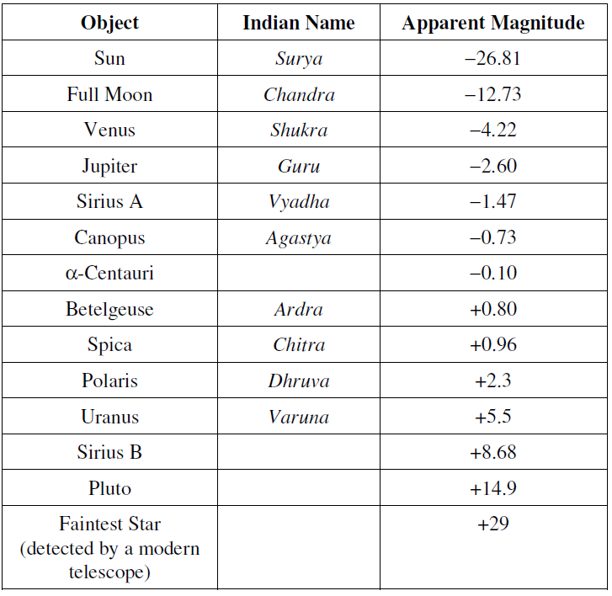

Slide 18
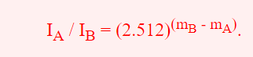
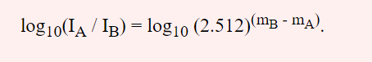
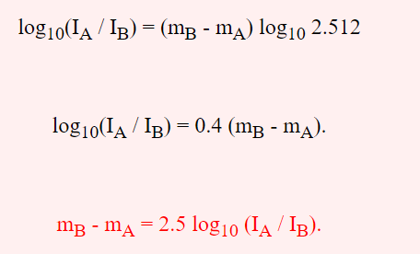
While the magnitudes are increasing linearly, the intensity ratios are increasing logarithmically in base 2.512.

Slide 19
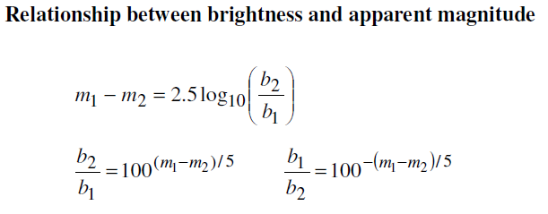
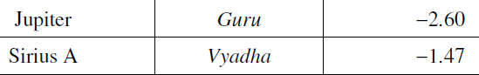
Which of the two objects is brighter? By how much?
Jupiter is approx. 2.83 times brighter than Sirius A.

Slide 20
The apparent magnitude and brightness of a star do not give us any idea of the total energy emitted per second by the star.
Luminosity and Radiant Flux
The luminosity of a body is defined as the total energy radiated by it per unit time. (in erg s⁻¹)
Radiant flux at a given point is the total amount of energy flowing through per unit time per unit area of a surface oriented normal to the direction of
propagation of radiation. (erg s⁻¹ cm⁻²)

Slide 21
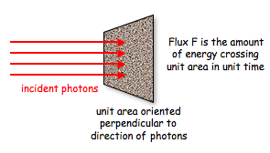
The radiant flux of a source depends on two factors:
(i) the radiant energy emitted by it, and
(ii) the distance of the source from the point of observation.

Slide 22
Is luminosity the same as brightness?
Luminosity is not the same as brightness. Brightness is the amount of watts per square meters. Brightness is based on the object's distance from the observer and can therefore change. Luminosity is the actual brightness of an object and does not change based on the observer's distance from the object.
To calculate the luminosity of a star using brightness, astronomers use the formula:
L = 4 x 3.14 x d² x b
Symbol | Meaning
L | Luminosity
3.14 | Pi, a mathematical constant for the ratio of a circle's circumference to its diameter
d | Distance, often measured in meters
b | Brightness, often measured in Watts per meter squared W/m²

Slide 23
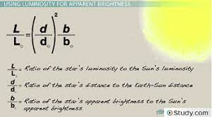

Slide 24
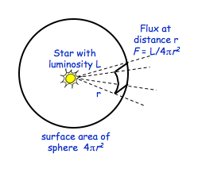
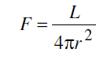
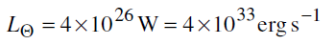

Slide 25
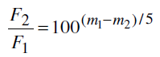
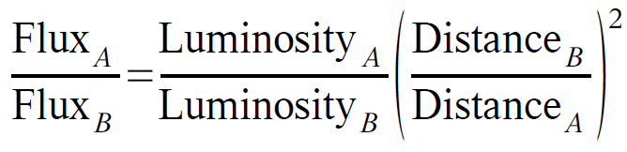
The energy from a source received at any place, determines the brightness of the source. This implies that F is related to the brightness b of the source: the brighter the source, the larger would be the radiant flux at a place.
Flux ~ 1/d².

Slide 26
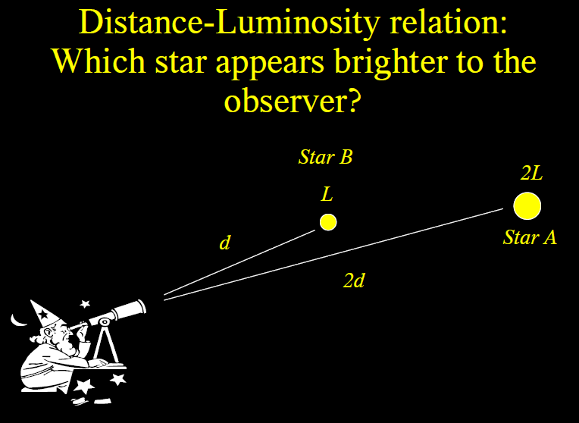
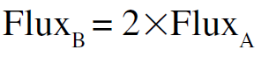

Slide 27
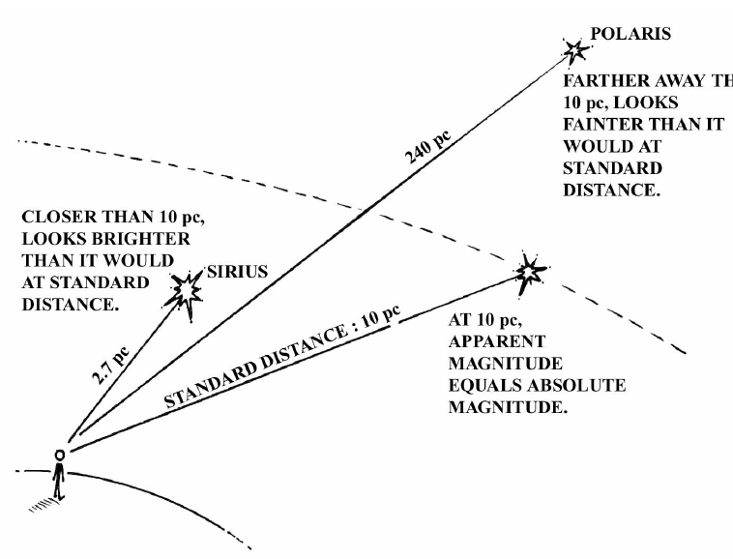
Absolute Magnitude
The absolute magnitude (M) of an astronomical object is defined as its apparent magnitude if it were at a distance of 10 pc from us.

Slide 28
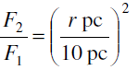
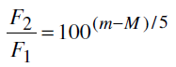
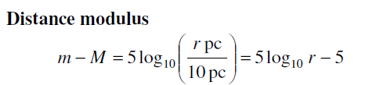
Absolute Magnitude (M) & Apparent Magnitude (m)

Slide 29
The distance modulus (m-M) of a star is −1.0. At what distance is it from us?
6.31 pc
b) If a star at 40 pc is brought closer to 10 pc, i.e., 4 times closer, how bright will it appear in terms of the magnitude?
16 times
c) A star at a distance of 20 pc is having m = -20. What will be its absolute magnitude?
M = -21.50

Slide 30
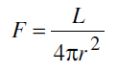
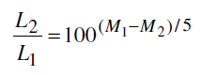
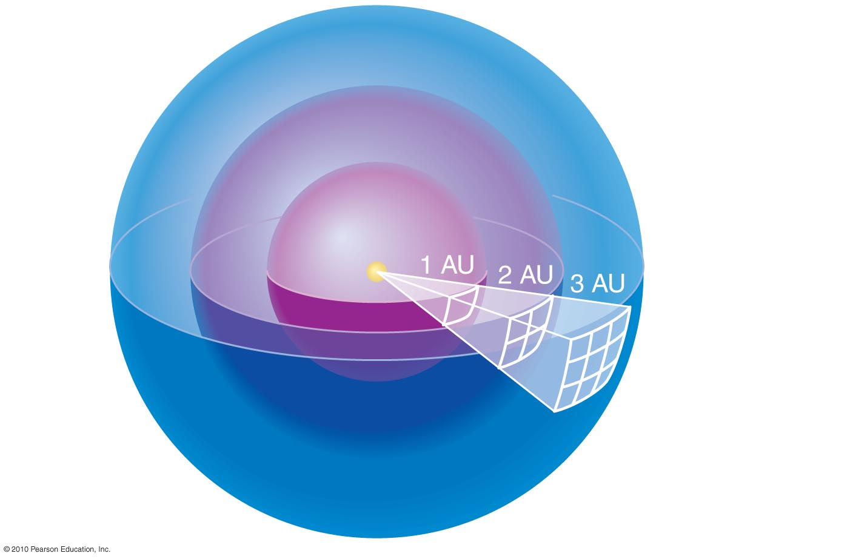


The ratio of radiant flux of two stars at the same distance from the point of observation is equal to the ratio of their luminosities.
The amount of luminosity passing through each sphere is the same.
Area of sphere: 4π (radius)²
Divide luminosity by area to get brightness

Slide 31
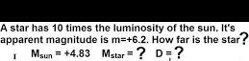

Slide 32
Cosmic Distance Ladder 4. Cepheid variables
The important feature of a Cepheid Variable that allows it to be used for distance measurements is that its period is related directly to its luminosity . This relation allows us to work out how much brighter than the Sun the star is. From there we can calculate how much further away the star must be than the Sun to make it the brightness we see from Earth.
Consider a Cepheid with a period of 11 days and an apparent magnitude m = 2.3.

Slide 33
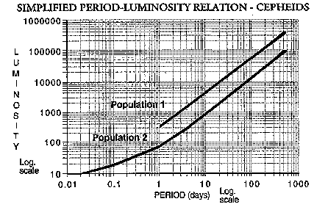
This corresponds to a magnitude difference of 10.
M_{SUN} = 4.8 → M_{star} = -5.2

Slide 34


Given m = 2.3, M = -5.2, calculate distance r.
316 pc
Most luminous stars: 10⁶ L_{Sun}
Least luminous stars: 10^{–4}L_{Sun}

Slide 35
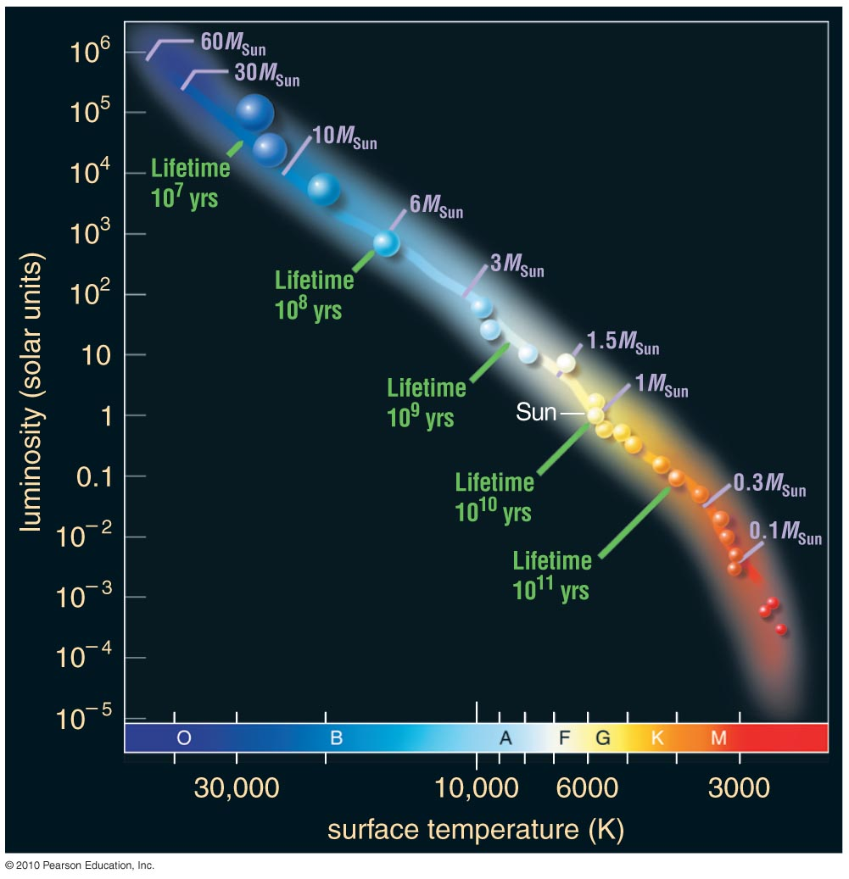

Slide 36
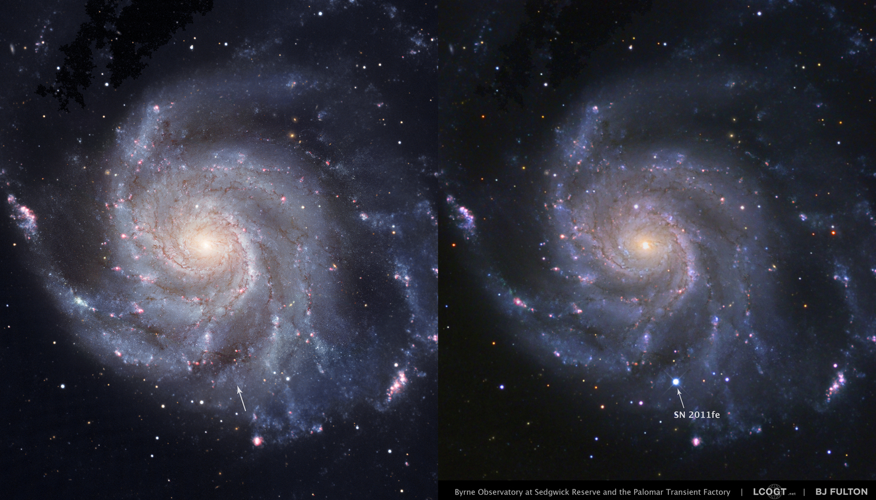
Cosmic Distance Ladder 5. Supernovae (Exploding Stars)

Slide 37
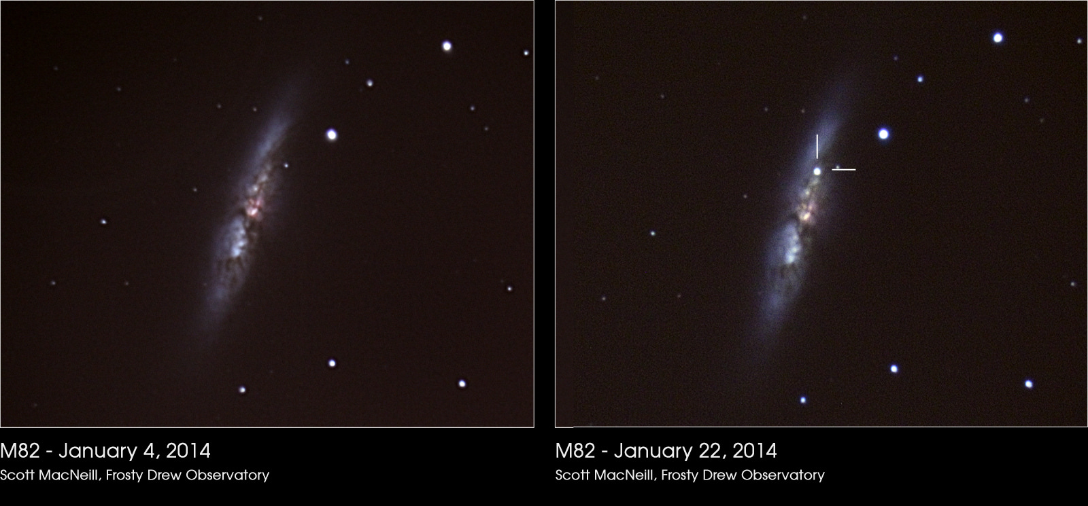

Slide 38
The good and bad aspects of supernovae as distance indicators
Good
Very luminous, so can be seen at very large distances. Astronomers have found supernovae well beyond z=1, with the most distant event at z=3.9! That means that supernovae can reach MUCH farther into space than any other method we have discussed.
Bad
Unpredictable: We cannot predict where and when a supernova will explode, so we cannot arrange in advance to observe them with a telescope. Most supernovae grow brighter for 2-3 weeks after the explosion, remain bright for 1-3 months, then fade to invisible within a year or two.

Slide 39
The last supernova to explode in the Milky Way, and be noticed by humans, happened in 1604: Kepler's Star.
Two other supernovae probably occurred in the Milky Way more recently (around 1680 and 1870), but were not noticed due to intervening dust and gas.
The star "S Andromeda" was a type Ia explosion in the Andromeda Galaxy, but it happened just a few decades before astronomers were ready with equipment powerful enough to study it properly.
Thirty years ago, in 1987, a supernova appeared in the Large Magellanic Cloud. It was close enough that neutrinos from the explosion were detected on Earth, but no event since then has even come close.

Slide 40
Astronomers use "standard candles", that is, the objects whose absolute magnitude is thought to be very well known. Then, by comparing the relative intensity of light observed from the object with that expected based on its assumed absolute magnitude, the inverse square law for light intensity can be used to infer the distance.
Supernovae Type I (which do occur regularly) is one such standard candle.

Slide 41
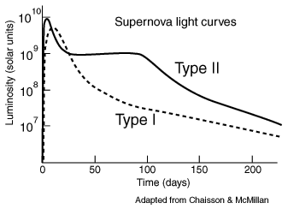

Slide 42
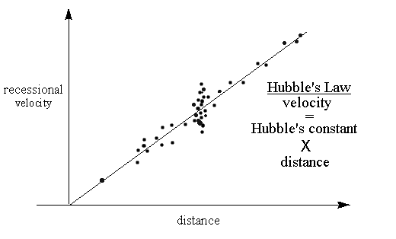
Cosmic Distance Ladder 6. Hubbles Law

Slide 43
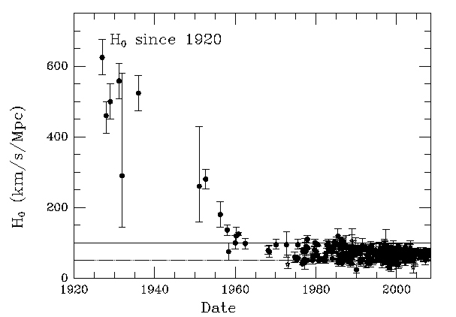

Slide 44
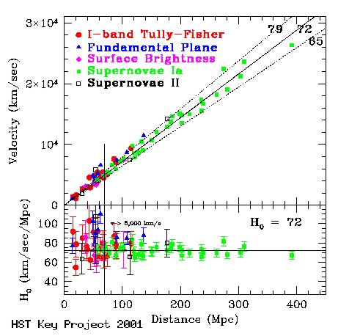

Slide 45
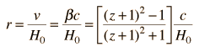
The Hubble Law states that the distance to a given galaxy is proportional to the recessional velocity as measured by the Doppler red shift the z-parameter, which is the fractional shift in the spectral wavelength. The Hubble distance is given by
The value of H₀ = 72 km/s/Mpc, yields an age for the Universe of ~ 13.7 Gyr.

Slide 46
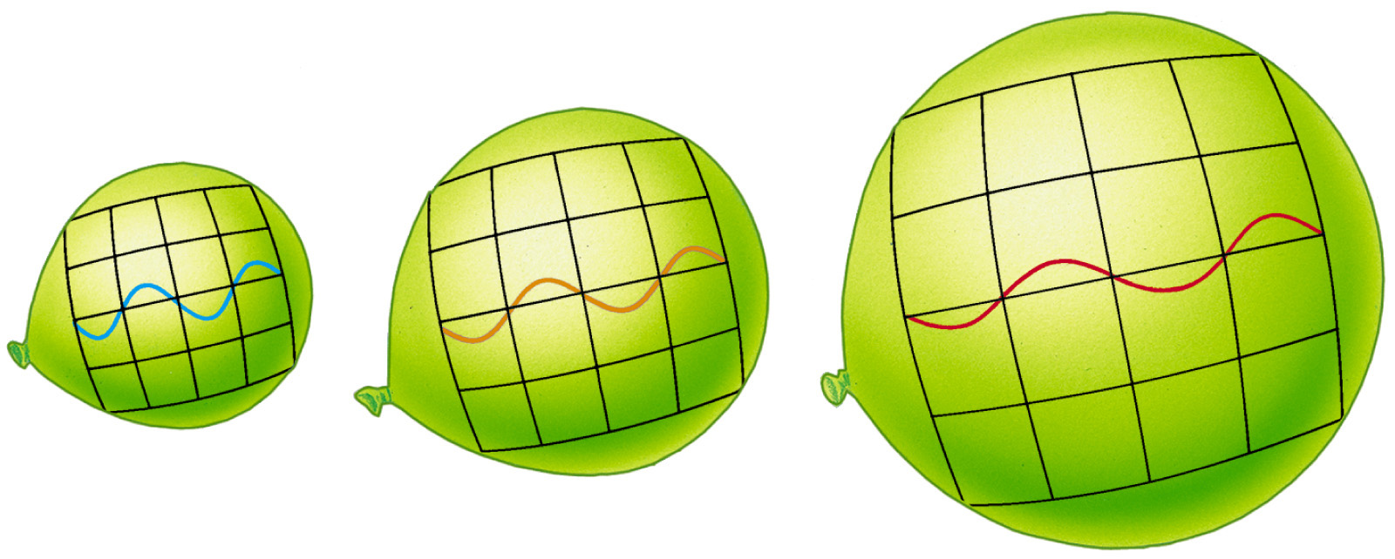
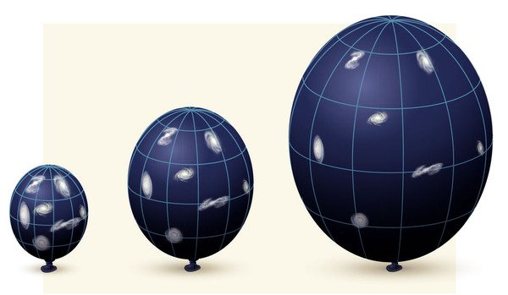

Slide 47
2. Stellar Radii (Direct)
Except for the Sun, all the stars in the sky are very far away, and their angular sizes are very small. Although the theoretical resolving power of modern large telescopes (such as the Keck telescope with 10-meter aperture) is about 0.01 arc-seconds. Atmospheric effects are also important.
The angular size of Betelgeuse was first observed using interferometry in 1921 → 0.051 arc-seconds.
R Doradus is the star with the largest observed angular size: 0.057 arc-seconds.
Size of star = angular size [radian] × distance

Slide 48
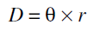
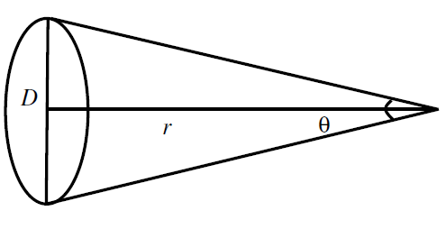
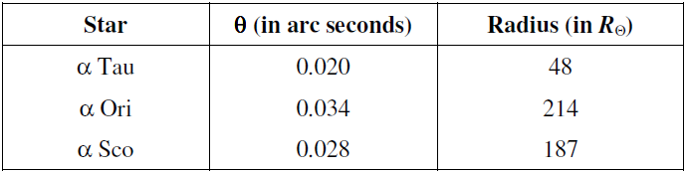

Slide 49
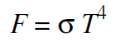
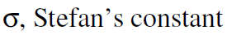






Slide 50



Slide 51
If we know the luminosity (from apparent brightness and distance measurements) and the temperature of the stars, then we can calculate their physical size:
Assuming that stars are blackbody
The energy output of a unit surface area on the surface of the star is determined by its temperature (Stefan-Boltzman Law)
The total energy output (luminosity) therefore depends on the temperature and its total surface area, which is related to its size.

Slide 52
Q: The surface temperatures of Sirius A and Sirius B are found to be equal. The absolute magnitude of Sirius B is larger than that of Sirius A by 10. How does their radii compare?

Slide 53
R₂ = 0.01 × R₁
Thus the radius of Sirius A is 100 times that of Sirius B.

Slide 54
Online tool to calculate distance for various stars from magnitude
https://javalab.org/en/magnitude_en/
aavso.org

Slide 55
The primary method is differential photometry, which means finding the difference of magnitude between star A and star B. Modern photometry is now done using CCD’s attached to the telescope where the eyepiece normally fits. The goal is to compare the number of photons collected from the target star and the comparison star. There are quite a few astronomical CCD capture programs that will tell you how many photons/electrons have been collected within a specified aperture setting.
Let me provide a simplified step by step method.
Star A is our target star. Star B is our comparison star. It is important that star B is a star that is known not to be a variable and has a catalogued magnitude.
It is easiest if both the target star and the comparison star are in the same field of view

Slide 56
If you want your measurement of apparent magnitude to be part of a collective effort in which observation results are collated, you will want to make use of a filter. The most common is a V (Visual) filter that operates in the green part of the spectrum. Many observers make use of 3 filters depending on the star - BVR - Blue, Visual (Green) Red/Infrared. With these one can find magnitude at different points of the light spectrum since most stars do not have equal magnitudes within the BVR range. Unfiltered observations are also useful, especially if the data is not going to be shared.
Here’s the results of observations I made several years ago of supernova SN2011dh. I obtained a star map from the AAVSO for the coordinates of SN2011dh. That map provided me with several comparison stars of similar magnitude of the expected supernova.
Date: 6/21/2011; Comparison star - 39197.9 e; SN2011dh - 98893.7 e.
After processing the CCD image, my software reported that my target star collected 39,197.9 electrons (total flux), and 98,893.7 electrons (total flux) for SN2011dh

Slide 57


Slide 58
If your purpose is to observe changes in magnitude over a period of time, you can stop here. If you want to convert the difference into an actual apparent magnitude (m) you have one more step:
m(target) = m(comp star) + delta.
In the case of my example, the comparison star has a magnitude of 13.615 and we observed a delta of -1.0047 between the comparison star and SN2011dh. Adding the two values results in a Magnitude 12.61 of SN2011dh.

Slide 59
3. Stellar Temperature Stars are black body radiators.
- A black body is a theoretical object that absorbs 100% of the radiation that hits it. Therefore it reflects no radiation and appears perfectly black.
- Roughly we can say that the stars radiate like blackbody radiators.
- At a particular temperature the black body would emit the maximum amount of energy possible for that temperature.
- Blackbody radiation does not depend on the type of object emitting it. Entire spectrum of blackbody radiation depends on only one parameter, the temperature, T.

Slide 60

Visible light falls in the 400 to 700 nm range
Stars, galaxies and other objects emit light in all wavelengths

Slide 61




Slide 62


Slide 63
Blackbody Experiment Results
The total power of the emitted radiation increases with temperature.
Stefan’s law : P = σ A e T⁴
σ = 5.67 x 10⁻⁸ W/m²K⁴
The emissivity, e, of a black body is 1, exactly.
The peak of the wavelength distribution shifts to shorter wavelengths as the temperature increases.
Wien’s displacement law
λ_{max}T = 2.898 x 10⁻³ m . K

Slide 64


Slide 65


Slide 66


Slide 67
To get a stellar temperature:
Measure the brightness of a star through two filters and compare the ratio of red to blue light.
Compare to the spectra of computer models of stellar spectra of different temperature and develop an accurate color-temperature relation.
Besides the fact that the spectra of stars are not quite Plank spectra, there is a another problem which is that there is stuff between the stars. This stuff is dust and it has properties similar to the upper atmosphere of the Earth - Blue light is more effectively scattered than Red light. This is called "interstellar reddening". So...
Most stars APPEAR redder than they really are. This means that if we use colors to estimate temperatures, then we will always measure stars to be cooler than their real temperatures.
Stars of a given Luminosity appear fainter than you would calculate given the distance and inverse sqaure law.
These things lead to all sorts of confusion.

Slide 68


Slide 69


Slide 70


Slide 71

Fortunately we have Spectral Types
A long time ago, astronomers recognized that different stars had dramatically different absorption lines in their spectra. Some had strong absorption lines due to Hydrogen and little else, some had no Hydrogen lines and many lines due to Iron, Calcium and other elements. The different spectral types were assigned letters with type "A" having the strongest Hydrogen absorption lines, type "B" the next strongest, and so on down the alphabet

Slide 72


Slide 73


Slide 74


Slide 75

Eg Balmer series (n=2 to n>2)
n | λ, air (nm)
3 | 656.3
4 | 486.1
5 | 434.0
6 | 410.2
7 | 397.0
∞ | 364.6
E = hν = hc/λ

Slide 76


Slide 77

Spectral class
https://www.youtube.com/watch?v=Y5VU3Mp6abI

Slide 78


Slide 79

Spectrum of the Star Altair

Slide 80

Hottest stars:
50,000 K
Coolest stars:
3000 K
(Sun’s surface is 5800 K.)

Slide 81

Level of ionization also reveals a star’s temperature.

Slide 82


4. Stellar Mass Stars comes in binaries.

Slide 83
BINARY SYSTEMS OF STARS
Mass is the most important property. Mass decides rest all other properties.
Two stars revolving around each other forms a binary system of stars. Majority of the stars are in Binaries, which help us to determine their masses. There has been observation of three and four companion too.
https://www.youtube.com/watch?v=AnE9EYgXxpU

Slide 84
1. VISUAL BINARIES
Individual stars can be resolved. They are bright and are relatively well separated (1-100 AU).
These are gravitationally bound but they do not interact, like accretion etc.
The brightest component has suffix ‘A’, the next ‘B’ and so on. Eg., Sirius A & Sirius B.

Slide 85


Slide 86


Slide 87

Problems:
Q1: The α Centauri system is 1.338 pc distant with a period of 79.92 earth years. The A and B components have a mean separation of 23.7 AU (although the orbits are highly elliptical).
What is the total mass of the system?

Slide 88



























































Slide 89
Q2. Observations reveal that the primary component, α Cen A has a mean distance of 11.2 AU from the system's barycenter. What is the mass of each of the component stars in the system?

Slide 90


































Slide 91
1. Determine semi-major axis using observed velocity (V), period (P)
Determining component masses of eclipsing binaries using velocity curves
2. Determine sum of masses using Kepler’s 3rd law
3. Determine mass ratio using a₁, a₂
a₁
a₂
4. Use sum, ratio to determine component masses
a = a₁ + a₂

Slide 92


3. ECLIPSING BINARIES
WHEN ONE OF THE STARS ECLIPSES THE OTHER (PARTIALLY OR FULLY)
RADIUS OF THE SMALL STAR

Slide 93



Slide 94



Slide 95


Slide 96


Slide 97
Going from this light curve, and spectra of the two stars measured at several times, to the physical parameters of each star involves several steps.
Step I
the radial velocity of each star
the width of the eclipses
which together yield
⇒ the size of each star
Step II
the radial velocity of each star
the period of the orbit
which together yield
⇒ the size of each orbit ⇒ the mass of each star
Step III
the temperature of each star
models of the emission by stellar atmospheres
which combined with size yields
⇒ the luminosity of each star
Step IV
the apparent magnitude of the system
which together with the luminosity of the stars yields
⇒ the distance to the system

Slide 98

Our example involves measurements of a star with the Kepler space telescope, which made very precise light curves. Take a look at its measurements of KIC 8736245.

Slide 99
Q: What is the period of this orbit? Express your answer in days, and in seconds.

Slide 100
Another important parameter is the inclination of the orbit, relative to our line of sight. If the orbit is face-on (in which case we can't see eclipses), the inclination is zero degrees; if the orbit is edge-on (in which case we CAN see eclipses), the inclination is 90 degrees. We'll just assume that this orbit is perfectly edge-on, which simplifies all the calculations.
If we zoom in on each of the two eclipses, we see that one is deeper than the other; we call the deeper one the primary eclipse, and the shallower one the secondary eclipse.

Slide 101


Slide 102
Note: If the brightness variations are periodic, all the data are time shifted to mimic the scenario in which the observations were made in one period. This is called ``phasing'' the data, and provides the most information about subtleties in brightness variations. Cepheid variables are identified by a characteristic shape to their light curves; phasing the data helps the eye discern that characteristic shape. (Note the lopsided shape to the light curve above.) A phase difference of 1 corresponds to one full period. In the light curve above, the phase range from 1 to 2 is an identical copy of phase 0 to 1 (look at the light curve and verify this last point). Two phases are shown to aid the eye in distinguishing the shape of the light curve.

Slide 103

Let's pick the secondary eclipse. The authors have made a model of the system which emphasizes the shape of the light curve during this dip
You can see that the model has a flat bottom; the light stays constant during the middle of the dip. Why?

Slide 104

Take a look at this close-up view of an eclipsing system. As star "A" moves to the left, and star "B" crosses in front of it to the right, we can identify four moments when the limbs of the stars first (or last) touch each other.
t₁ is "first contact", when star B first touches star A
t₂ is "second contact", when star B's disk fully enters the disk of star A
t₃ is "third contact", when star B's disk starts to leave the disk of star A
t₄ is "fourth contact", when star B last touches star A

Slide 105
Each mark is 0.01 units of phase.
Q: The width at the top of the dip is (t₄ - t₁). What is this time, measured in phase (fractions of a period)? What is this time, measured in seconds?
Q: The width at the bottom of the dip is (t₃ - t₂). What is this time, measured in phase (fractions of a period)? What is this time, measured in seconds?

Slide 106
What is the duration of the eclipse? Measure the two widths and average them. Express the result in terms of "phase" = fraction of the period, and in terms of seconds.

Slide 107

The final piece of information we need is the velocity of each star in its orbit. We can derive these speeds using spectra of each star measured at several locations in the orbit. The Doppler shift of the lines yield the radial velocities of each star -- that is, the motion of each one toward or away from us.
the radial velocities at eight moments during the orbit. Note that the average speed of each star is not zero, but around +12 km/sec. That means that the entire binary system as a whole is moving away from the Sun at a systemic velocity of 12 km/sec.

Slide 108
Q: What is the amplitude of each star's motion? In other words, what is the maximum speed away from the systematic velocity for each star?

Slide 109


the size of each star. Look closely at the motion of the two stars as the eclipse happens. Since the two stars are moving in opposite directions as they pass each other, their RELATIVE speed is simply (v_{A} + v_{B}). Let's fix the star B in place, and watch as the star A moves across it from right to left at this combined speed. During the time period from first to fourth contact, the star A must move a distance of R_{B} + R_{A} + R_{A} + R_{B}.

Slide 110



Slide 111

(t₄ - t₁) = 17300 s (t₃ - t₂) = 6050 s (v₁ + v₂) = 150 km/s

Slide 112

2. SPECTROSCOPIC BINARIES
If binaries are not visual and well separated, they can still be identified by the Doppler shift of the spectral lines they emit.
If the stars are of different spectral types, their spectrum will be different.
The absorption in the composite spectrum will be seen to move in wavelength.
At smaller eccentricities, the orbital speed is essentially constant =

Slide 113


Slide 114


Slide 115


Slide 116
Doppler shift
Radial Velocity of the object can be known.
Δλ = λ_{rest} x V_{radial}/c = λ_{new} - λ_{rest}
λ_{new} > λ_{rest}: The object is moving away: red shifted
λ_{new} < λ_{rest}: The object is moving towards us: blue shifted
This observation of spectral shift is important in determining the fact that the far of galaxies are moving away faster: THE UNIVERSE IS EXPANDING AND ACCELERATING

Slide 117

Inclination angle affects observed radial velocities
For circular orbits with I=90° velocity curves are sinusoidal. Inclination will reduce amplitude

Slide 118


Slide 119

Eccentricity will change velocity curve to be non-sinusoidal. Can estimate eccentricity from deviation from sinusoidal shape

Slide 120


Slide 121

Almost Circular Orbits

Slide 122


Slide 123






Slide 124





SINGLE LINE SPECTROSCOPIC BINARIES

Slide 125


Visual Binary – Sirius
Sirius (in constellation Canis Major) is the brightest star in the night-time sky (magnitude -1.4). It is a visual binary system. Sirius A (the larger of the two) is a main sequence star with spectral type A0, and Sirius B is a white dwarf.
Hubble Space Telescope image of
Sirius
Sirius A & B time sequence

Slide 126

Algol – Eclipsing Binary
Algol (the demon star) is in the constellation of Perseus.
Algol A: main sequence star, more massive.
Algol B: subgiant, less massive.

Slide 127
http://spiff.rit.edu/classes/phys370/lectures/eclipse_1/eclipse_1.html

Slide 128







Over a period of 10 years, two stars separated by an angle of 1 arcsec are observed to move through a full circle about a point midway between them on the sky. Suppose that over a single year, that midway point is observed itself to wobble by 0.2 arcsec due to the parallax from Earth’s own orbit
How many pc is this star system from earth?
What is the physical distance between the stars, in au.
In solar masses, what are the masses of each star, M1 and M2.

Slide 129




Compute the luminosity L (in units of the solar luminosity L_o), absolute magnitude M, and peak wavelength λmax (in nm) for stars with (a) T = T_o; R = 10R_o, (b) T = 10T_o; R = R_o, and (c) T = 10T_o; R = 10R_o. If these stars all have a parallax of p = 0.001 arcsec, compute their associated apparent magnitudes m.

Slide 130



Slide 131






Suppose a star has a parallax p = 0.01 arcsec, peak wavelength λmax = 250 nm, and apparent magnitude m = +5 . About what is its:
Distance d (in pc)?
Distance modulus m − M?
Absolute magnitude M?
Luminosity L (in L)?

Slide 132






Surface temperature T (in T_o)?
Radius R (in R_o)?
Angular radius α (in radian and arcsec)?
Surface brightness relative to that of the Sun B/B?

Slide 133
Friedrich Bessel was the first to use a parallax to measure a star’s distance, for 61 Cygni, a binary system. Using the orbit of Earth, he found the parallax to be 0.3136 arcsec. Based on his measurement, what is the distance to 61 Cygni in parsecs and light-years?

Slide 134
Suppose two stars have a luminosity ratio L2/L1 = 100. a. At what distance ratio d2/d1 would the stars have the same apparent brightness, F2 = F1?
For this distance ratio, what is the difference in their apparent magnitude, m2 − m1?
What is the difference in their absolute magnitude, M2 − M1?

Slide 135
What is the difference in their distance modulus?
If the stars have a surface brightness ratio of I2/I1 = 100, what is the stellar radius ratio, R2/R1?

